Slide 1
Apprenticeship Myth Busting

Slide 2
Here’s what you will gain if you apply for an apprenticeship...
A fair deal - get paid while you’re getting work experience
A mix of learning on the job and studying
Recognised – you’ll get a qualification that employers respect
A commitment – it’ll take 1-4 years to complete

Slide 3
Q: Can an apprentice still achieve a degree?
No, apprentices are just for lower levels
Yes, it will part of your apprenticeship
No, because you don’t get UCAS points

Slide 4
A: Yes!
Apprentices can achieve a degree through a degree apprenticeship!
A couple of years ago, the government introduced degree apprenticeships. This means that you can now study all the way up to degree level (and even master's level).
Not all apprentices will leave school and go straight onto a degree apprenticeship. Most apprentices will need to complete an intermediate, advanced or higher apprenticeship before progressing on.

Slide 5
Q: Is an apprenticeship a real job?
Yes
No
Sometimes – it depends on the employer

Slide 6
A: Yes!
An apprenticeship is a real job - with the added benefit of training.
You are learning as you work, whilst completing more formal off-the-job training at least 20% of your time.

Slide 7
Q: Does an apprentice have to pay for their own training?
Yes
No
You may have to contribute some of the fees, depending on the course

Slide 8
A: No
Apprentices do not pay for the training.
The employer and government pay for all the training costs, meaning that you can access a fantastic range of apprenticeship standards and qualifications without incurring any student debt.
Plus, remember you'll be working at the same time, building up valuable experience in the workplace too!

Slide 9
Q: Will you be entitled to holiday pay as an apprentice?
Yes
No
Yes, after you have completed 6 months of your course.

Slide 10
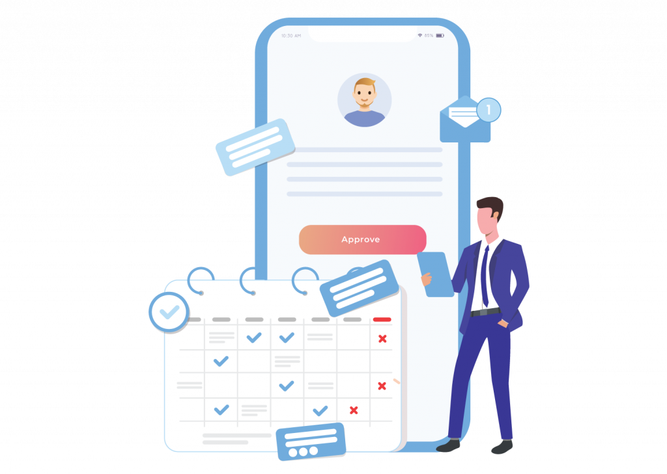
A: Yes
Apprentices have all the same rights and responsibilities as other employees within an organisation.
You will be legally entitled to 20 days paid holiday per year. However, if your employer gives their workers 30 days holiday a year, you would be entitled to the same! After all, you are an employee in a real job.
This goes for sick leave and flexitime procedures too.

Slide 11
Q: Where does most off-the-job training take place?
At the employer's premises
At one day a week at college
At a university, every 2 weeks

Slide 12
A: At the employer's premises
Most apprentices complete their off-the-job training at their workplace.
However, the training element comes in many forms and will depend on the course and what works best for you and your employer.
So, it could be day release, in the workplace, block release or a mixture.
You do get paid for this time away from your day-to-day job too!

Slide 13
Q: Apprentices are only for young people aged 16-18?
True or False

Slide 14
A: False
Not true!
Apprenticeships are open to all people 16+ that want to learn new skills as part of a real job - it doesn’t matter how old you are.
In 2016, 39% of all people that started an apprenticeship were over the age of 24, some were even in their 60’s!

Slide 15
Q: Which is the fastest growing group of apprenticeships in England?
Intermediate Apprenticeships (GCSE-Level)
Advanced Apprenticeships (A-Level standard)
Higher & Degree Apprenticeships (University-level)

Slide 16
A: Higher and Degree Apprenticeships
Higher and degree-apprenticeships are the fastest growing of any kind of apprenticeship, with almost 65% more starts in 2016/17 than the previous academic year.
This shows there are more and more opportunities to progress through the apprenticeship route or jump straight in at a higher level.

Slide 17
Q: What is the average salary for an apprentice studying an intermediate (level 2) or advanced (level 3) apprenticeship?
£7,215 per year
£12,890 per year
£13,065 per year

Slide 18
A: It's £13,065 per year!
There is a national minimum wage for apprentices, although many employers pay more than this.
Don't forget that you won't be paying for any of your qualification or training costs either.
The minimum wage for apprentices aged under 19 is currently £4.15 per hour.

Slide 19
Q: Most apprenticeships are in hairdressing or construction?
True or False

Slide 20
A: False
It's not true!
The three biggest areas in 2017 were Business, Health and Engineering.
Plus, new apprenticeships are coming along all the time, such as:
Aerospace Engineer
Cyber Security Technologist
Nuclear Scientist
Nurse
Solicitor
Teacher
And many, many more! Make sure you check out your options.

Slide 21
Q: Who is more likely to have a job six months after completing their studies?
A Graduate
An Apprentice

Slide 22
A: An Apprentice
Research shows that 91% of apprentices are in work on completion of their apprenticeship compared to 74% of graduates.
Not only that, but roughly nine in ten apprentices are satisfied with their apprenticeship and 80% feel that their employer is actively supporting their career development.

Slide 23
Why should you choose an apprenticeship?
1 – 4
is the number of years an apprenticeship can take depending on how far you want to take the learning
£0 Student Debts
51%
of companies said the average time for an apprentice to reach management was five years or less
It’s an opportunity to learn the theory and apply it practically
89%
of apprentices are satisfied with their apprenticeship programme
90%
stay in work post-apprenticeship
25%
More employable after completing higher apprenticeship
71%
of apprentices stay with the same employer
Qualifications on offer go up to degree level or even masters level
Earn while you learn
8,000+
Different courses to choose from

